Slide 1
Database Section

Slide 2
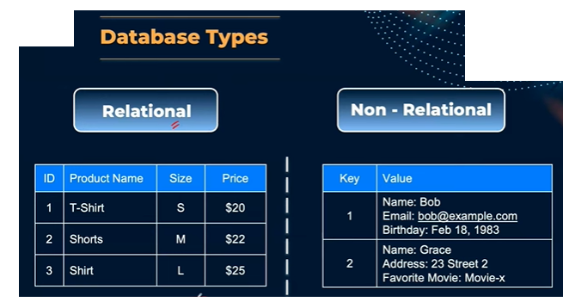

Slide 3
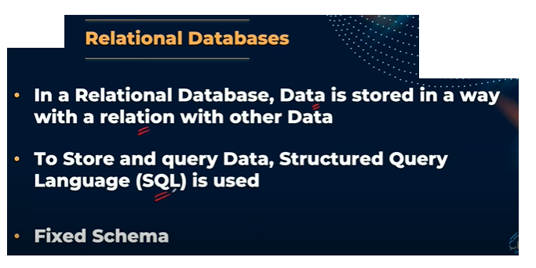

Slide 4
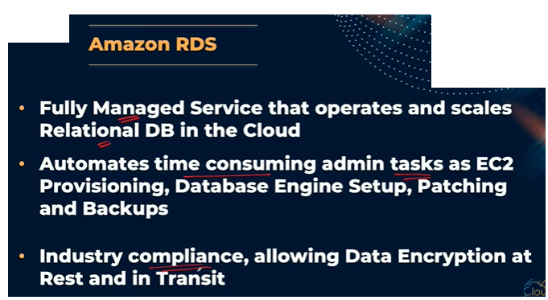

Slide 5
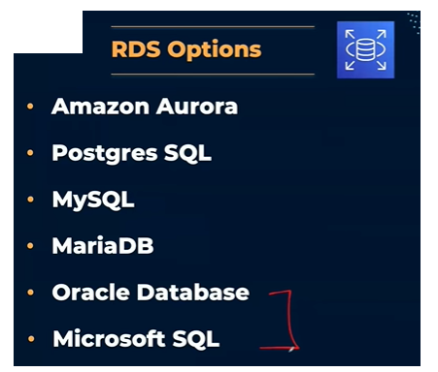

Slide 6

Databases
Sometimes, you want to store data in a well-structured system
In a database:
You can structure the data
You can build indexes to efficiently query / search through the data
You can define relationships between your datasets

Slide 7
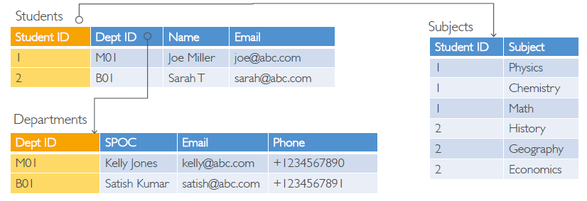
Relational Databases
Looks just like Excel spreadsheets, i.e., table, and links between them
You can use the SQL language to perform queries / lookups

Slide 8
NoSQL Databases
NoSQL = non-SQL = non relational databases
NoSQL databases are purpose built for specific data models and have flexible schemas for building modern applications.
Benefits:
Flexibility: easy to evolve data model
Scalability: designed to scale-out by using distributed clusters

Slide 9
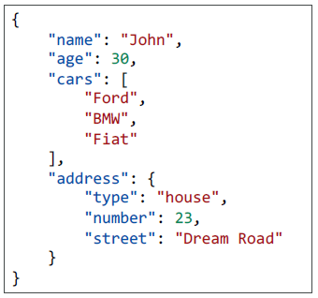
NoSQL data example: JSON
JSON is a common form of data that fits into a NoSQL model
Data can be nested
Fields can change over time
Support for new types such as arrays

Slide 10
AWS RDS Overview
RDS stands for Relational Database Service
It’s a managed (server-based) DB service for DB use SQL as a query language.
It allows you to create databases in the cloud that are managed by AWS with many DB Engine types:
Postgres
MySQL
MariaDB
Oracle
Microsoft SQL Server
Aurora (AWS Proprietary database ,cloud optimized)

Slide 11
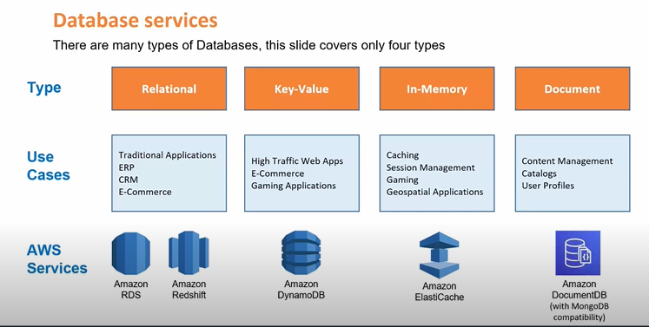

Slide 12
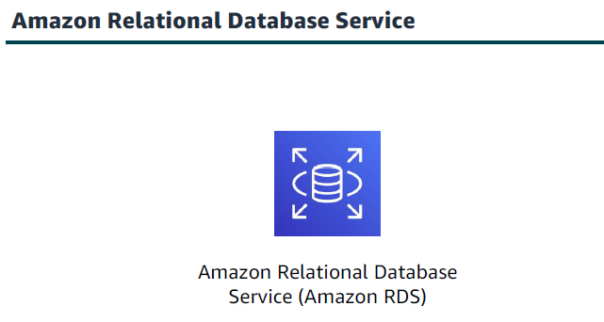
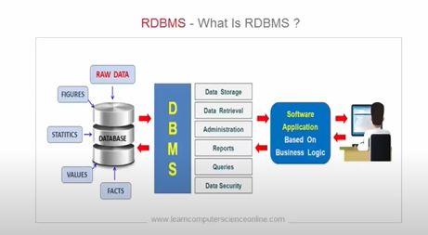
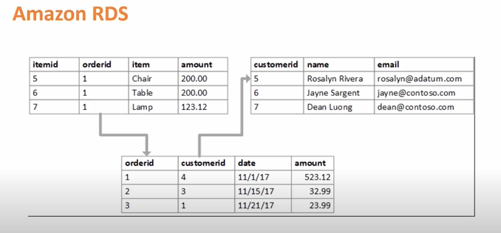
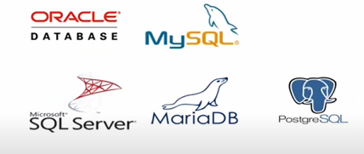

Slide 13
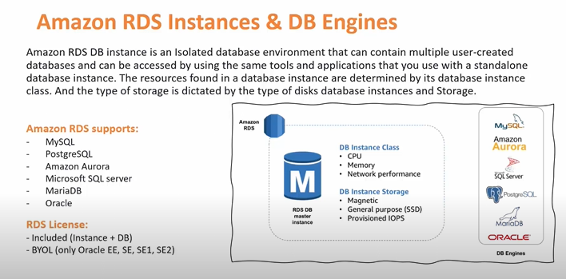

Slide 14
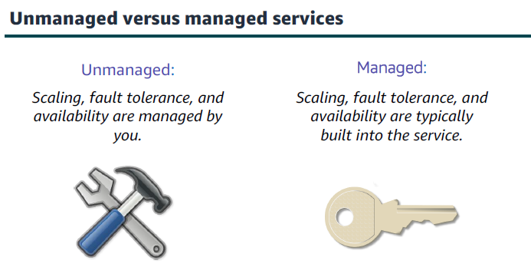

Slide 15
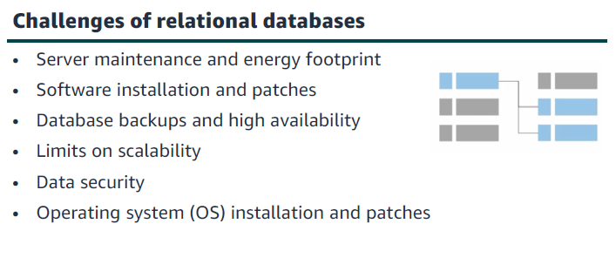

Slide 16
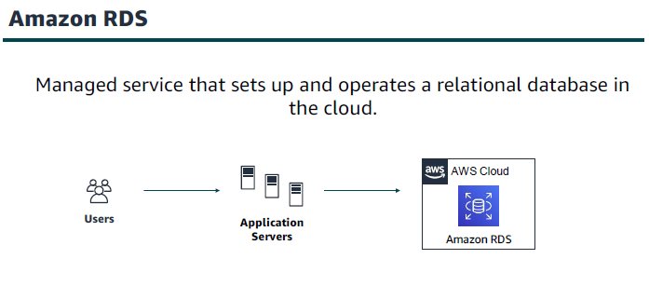

Slide 17
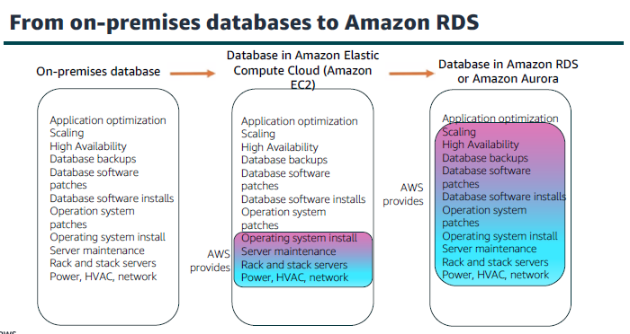

Slide 18
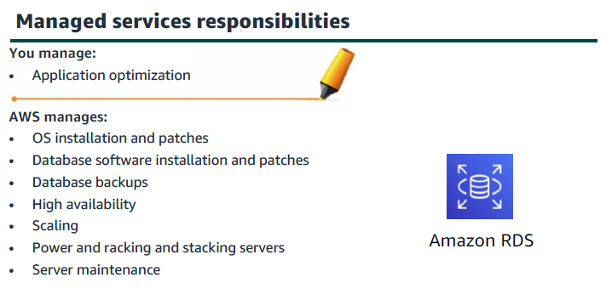

Slide 19
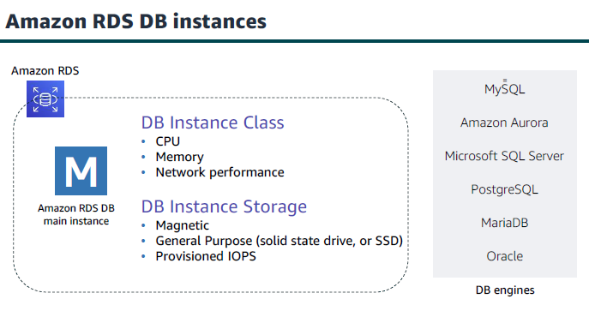

Slide 20
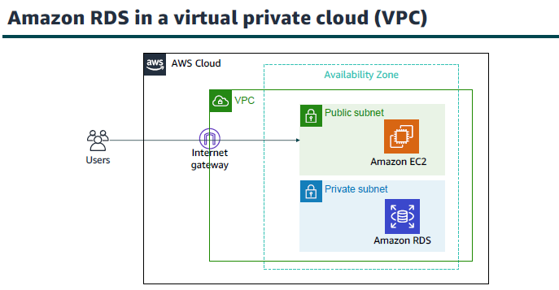

Slide 21
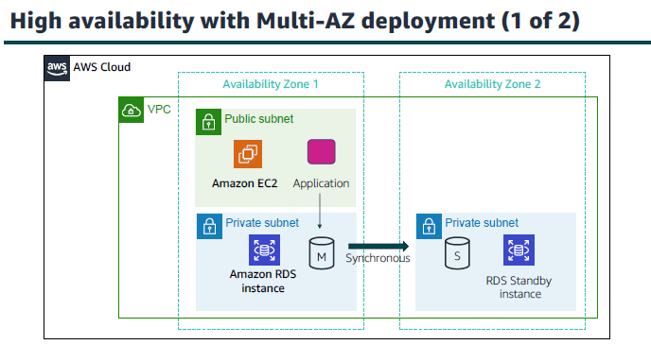

Slide 22
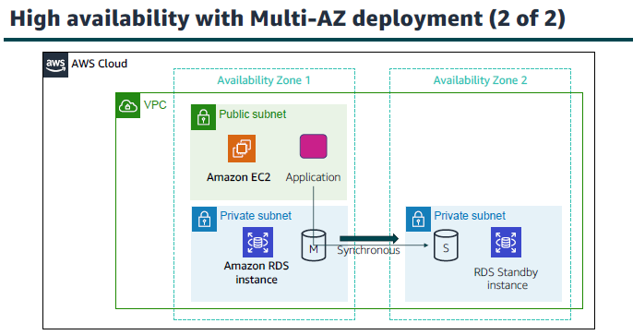

Slide 23
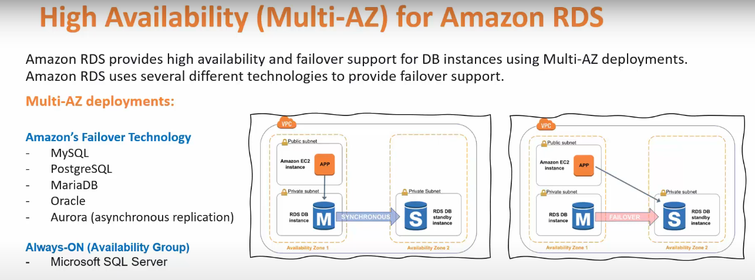

Slide 24
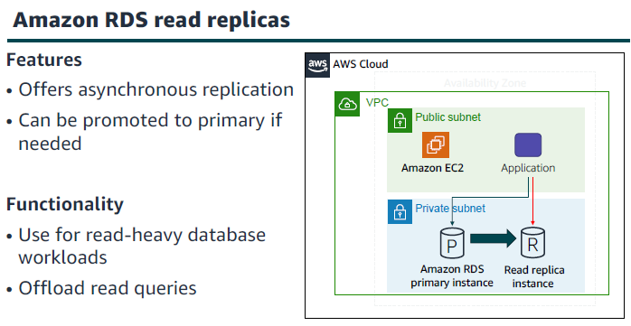

Slide 25
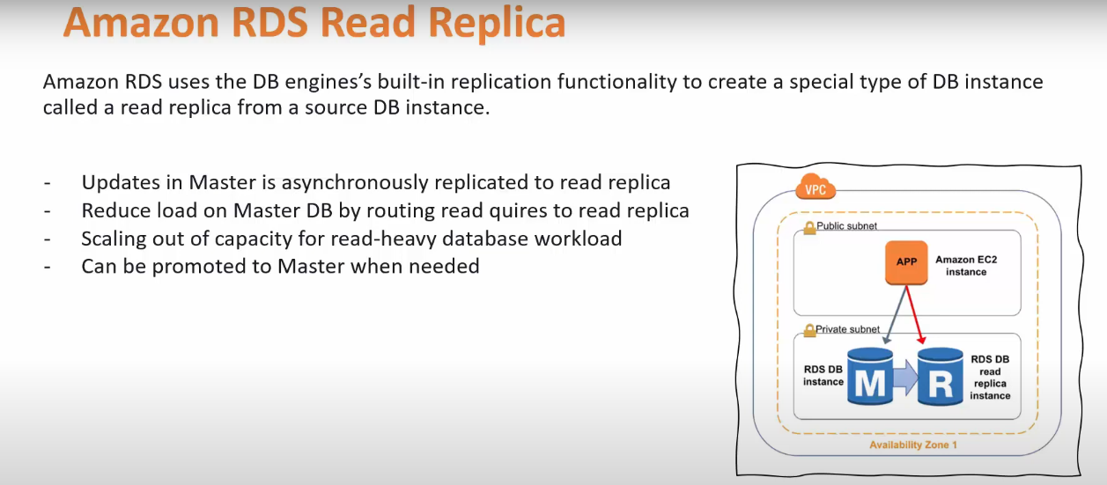

Slide 26
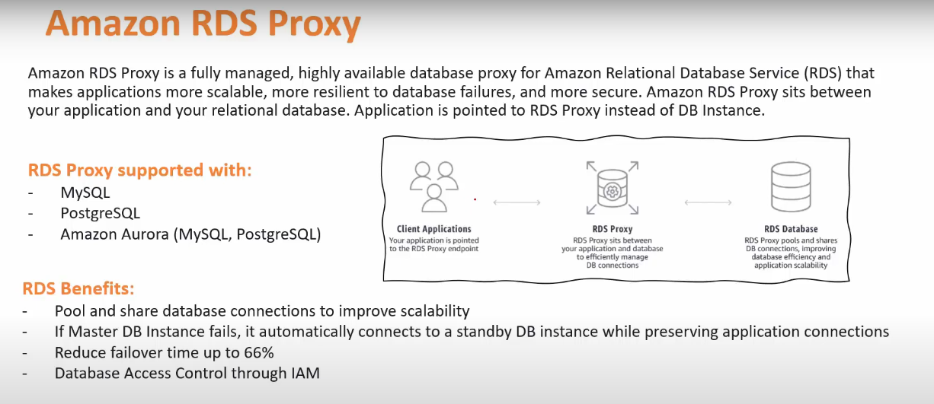

Slide 27
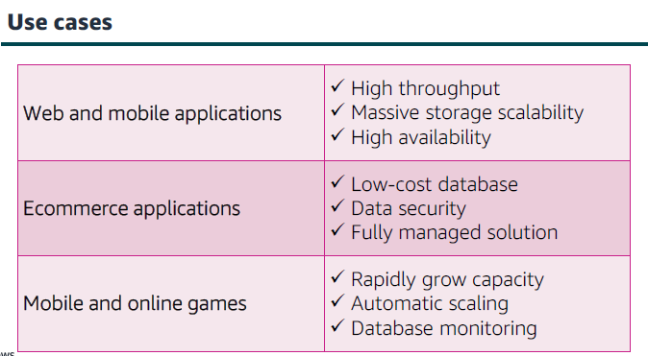

Slide 28
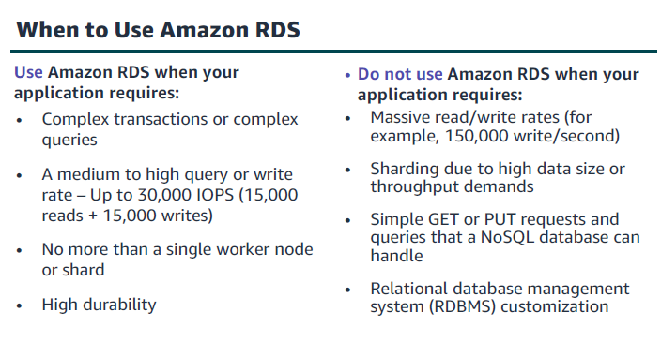

Slide 29
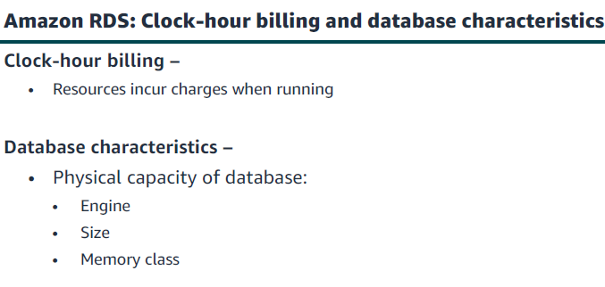

Slide 30
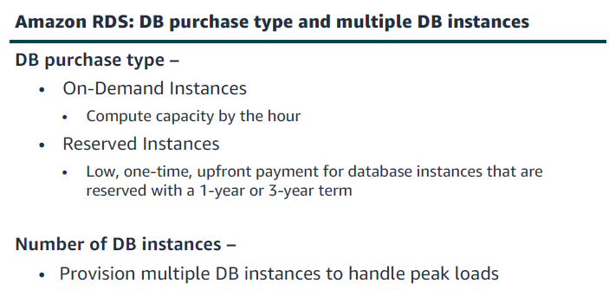

Slide 31
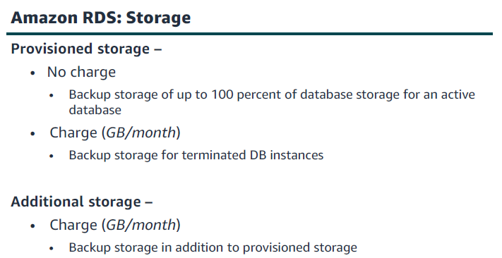

Slide 32
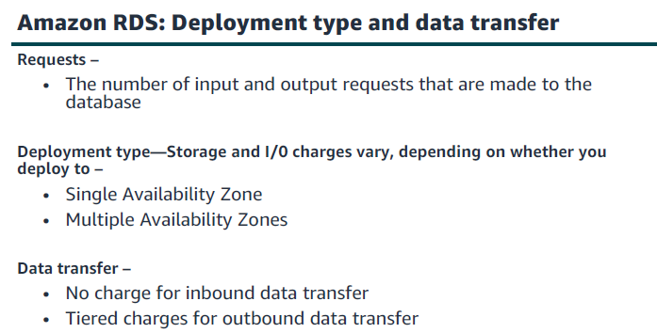

Slide 33
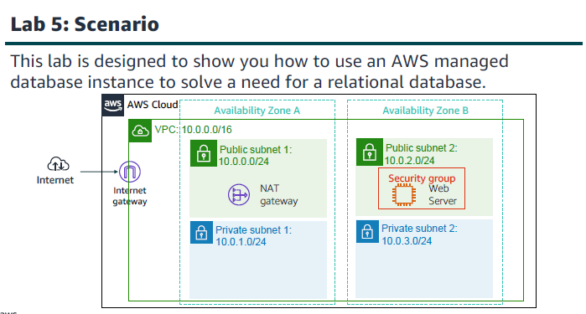

Slide 34
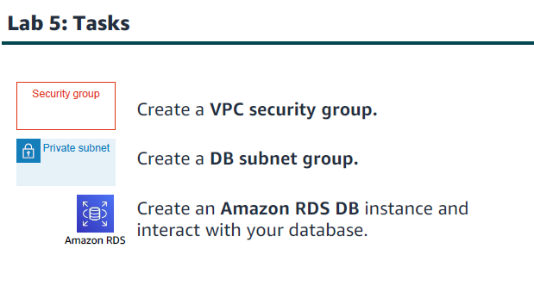

Slide 35
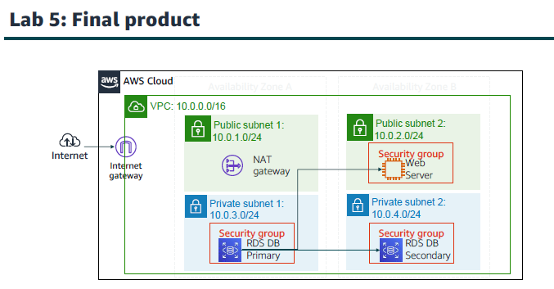

Slide 36
Database LAB
Task 1: Create a Security Group for the RDS DB Instance
Task 2: Create a DB Subnet Group
Task 3: Create an Amazon RDS DB Instance
Task 4: Interact with Your Database

Slide 37
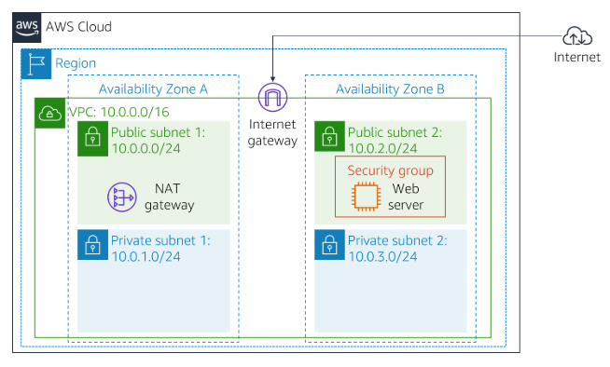

Slide 38
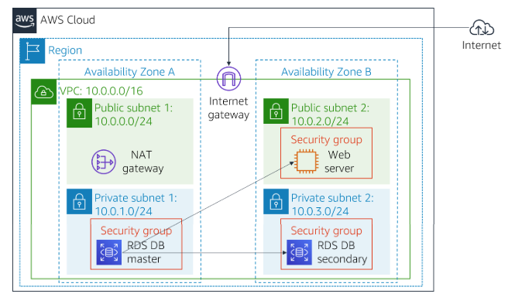

Slide 39
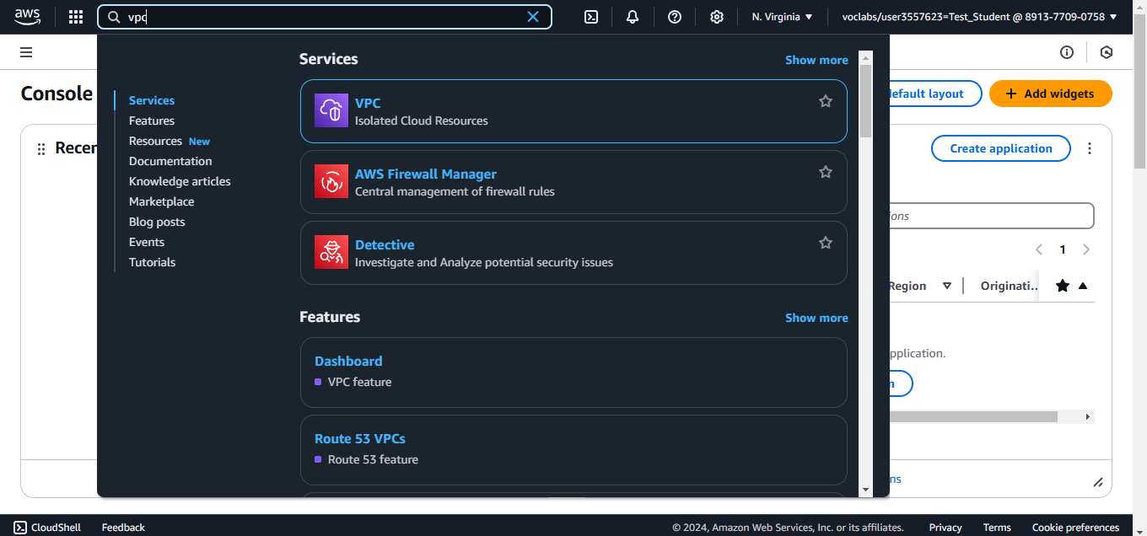
Search for VPC

Slide 40
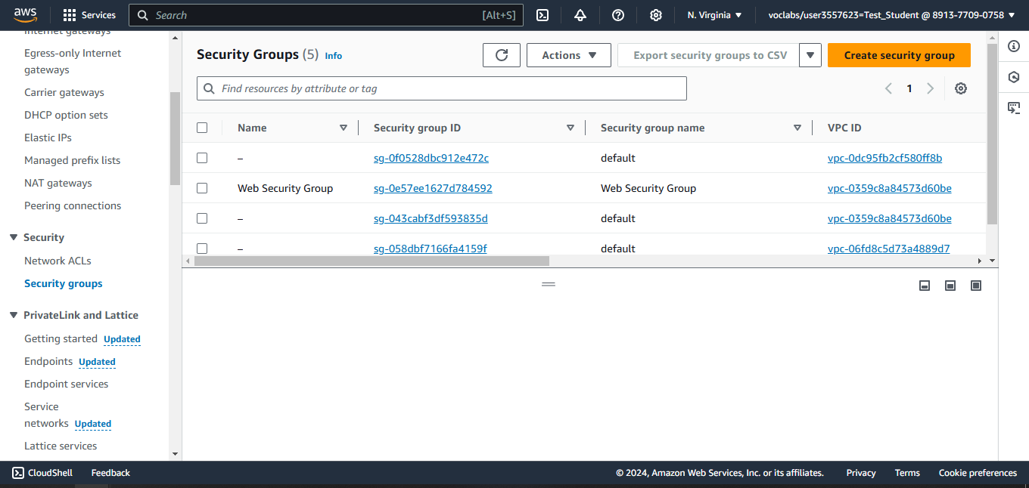
Create a new Security Group for the DB instance

Slide 41
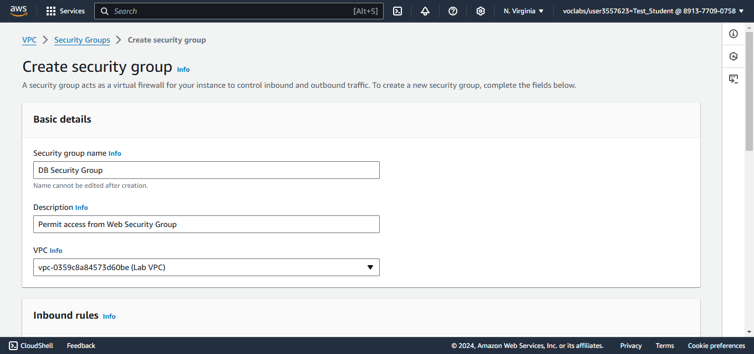
Configure Name, Description, and VPC

Slide 42
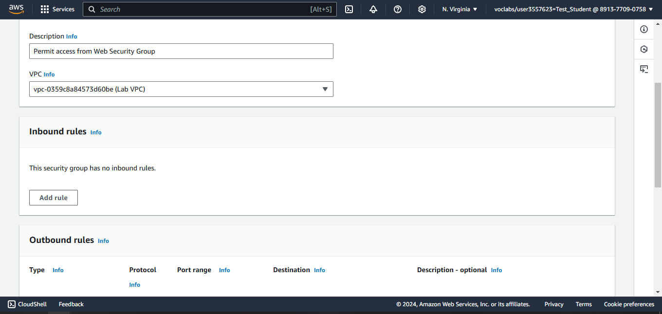
Add a new Inbound Rule

Slide 43
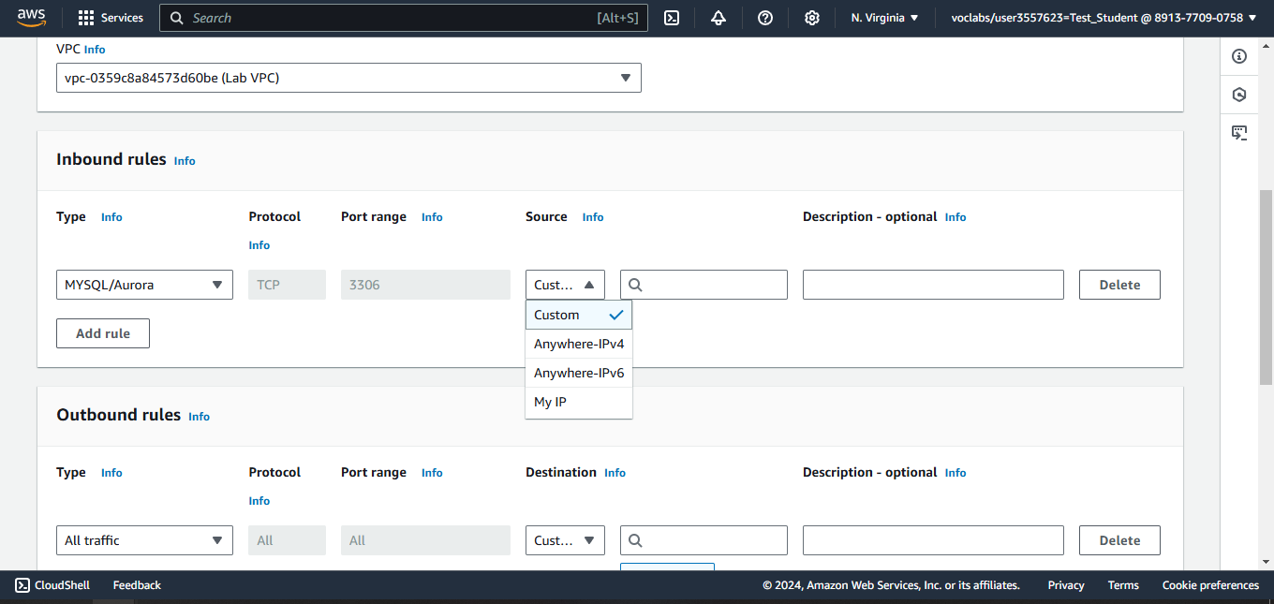
Configure the Type, Source Fields

Slide 44
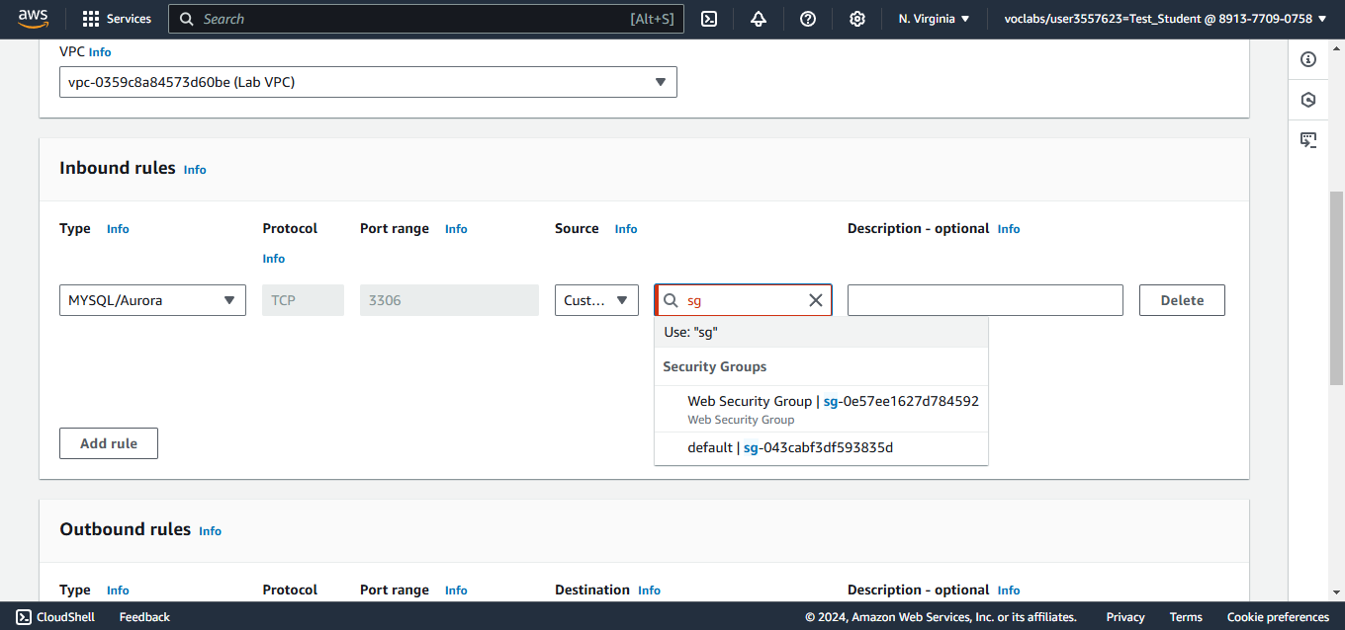
Configure the Source field to be the web security group

Slide 45
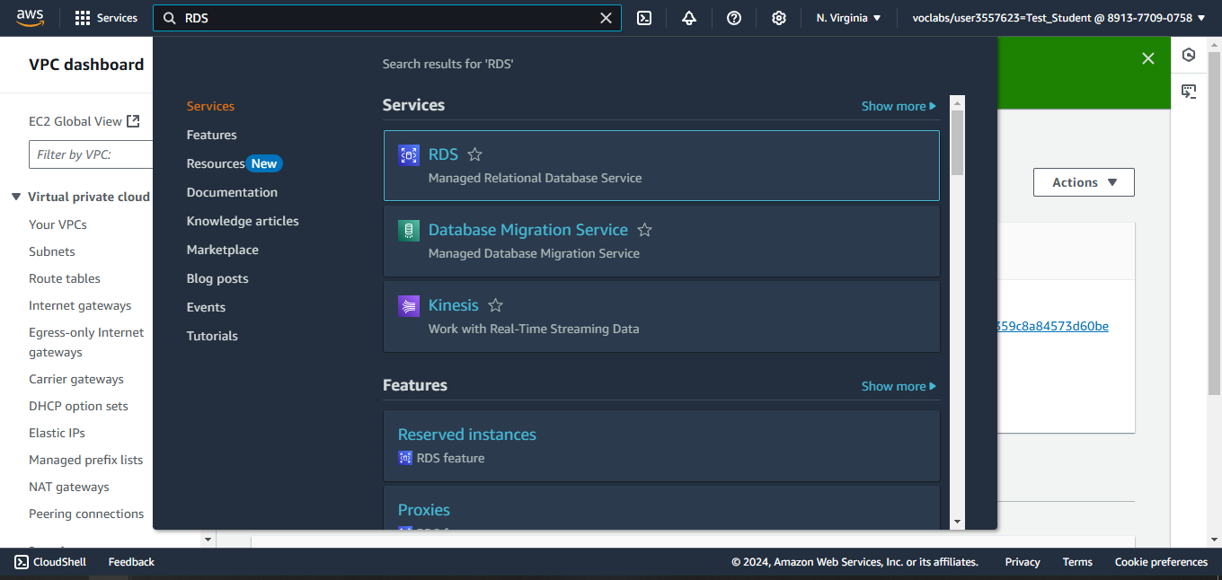
Search for RDS

Slide 46
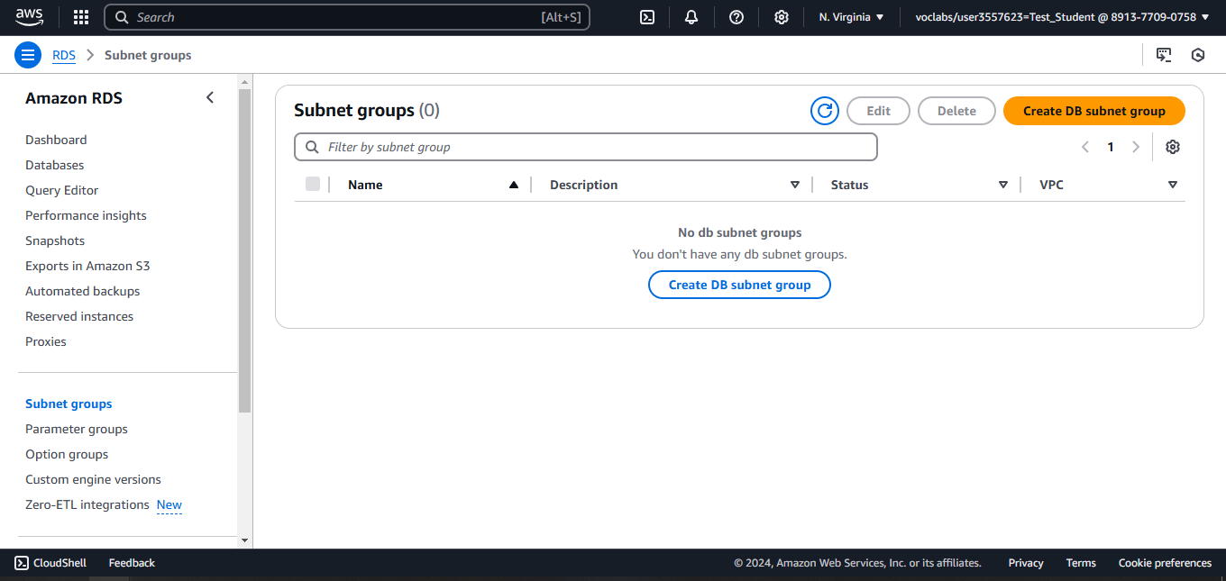
Create a DB subnet group

Slide 47
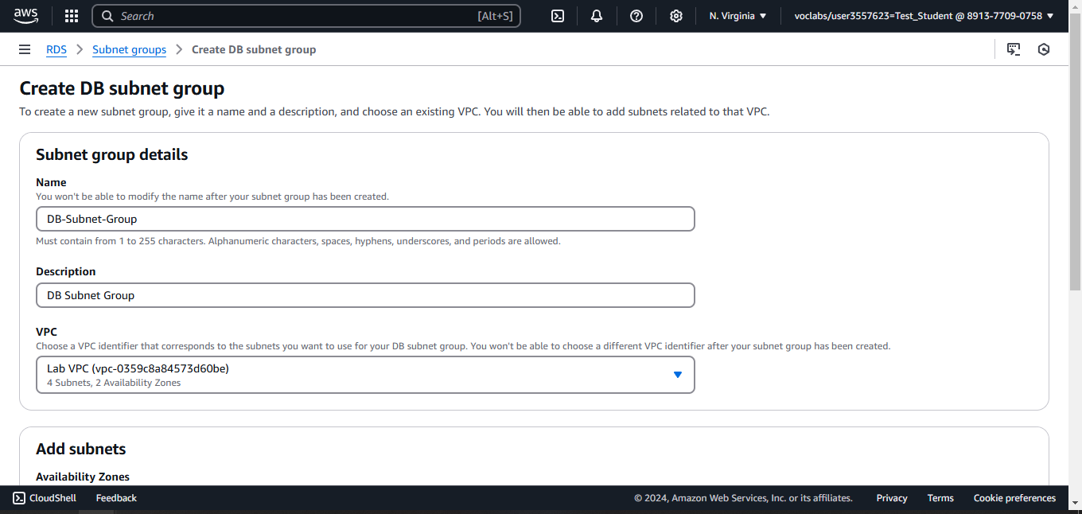
Configure the Name, Description, and VPC

Slide 48
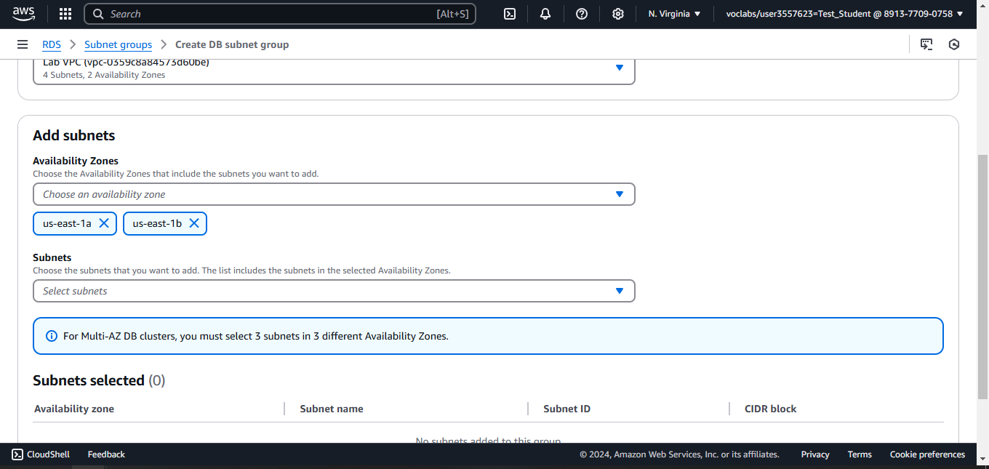
Choose the AZs

Slide 49
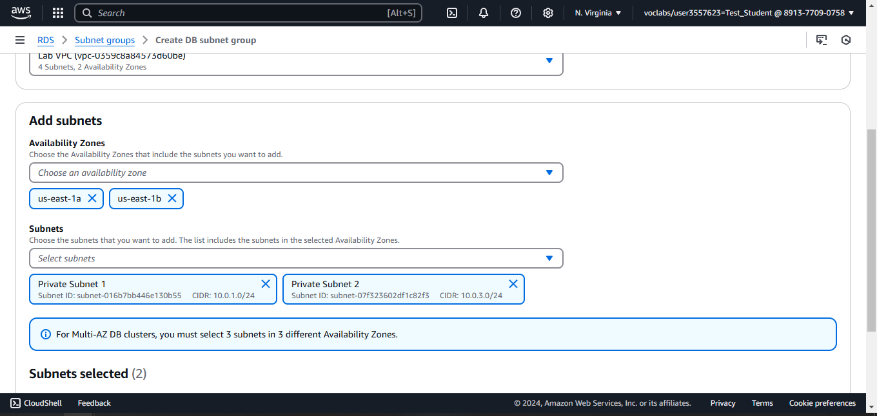
Choose the Subnets

Slide 50
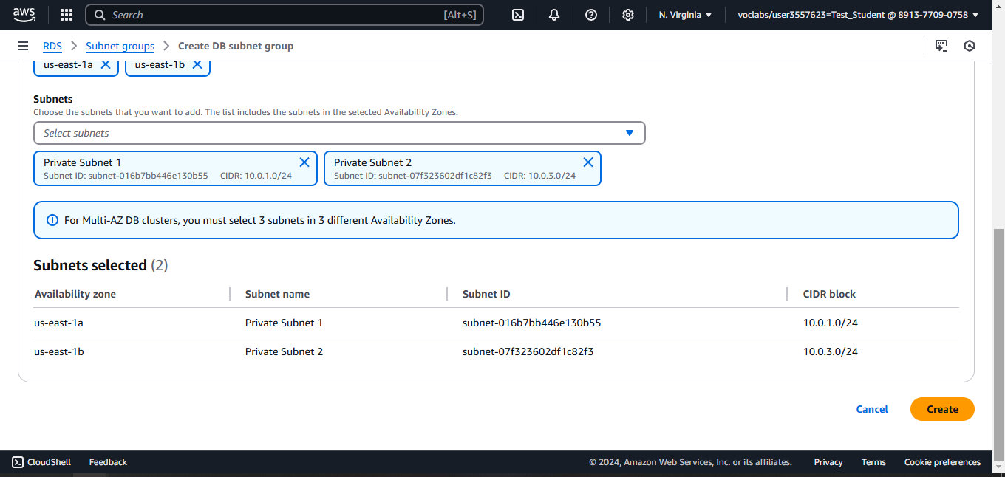
Create the DB subnet Group

Slide 51
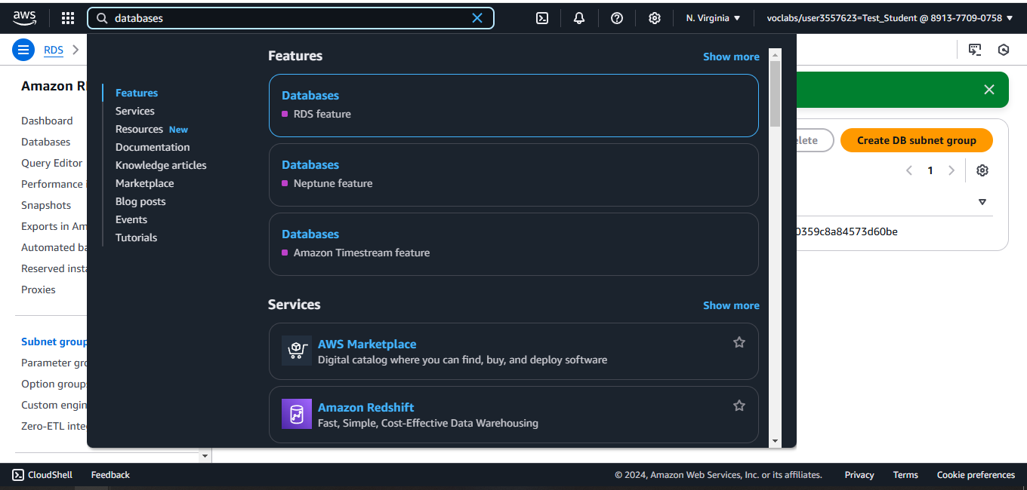
Search for Databases

Slide 52
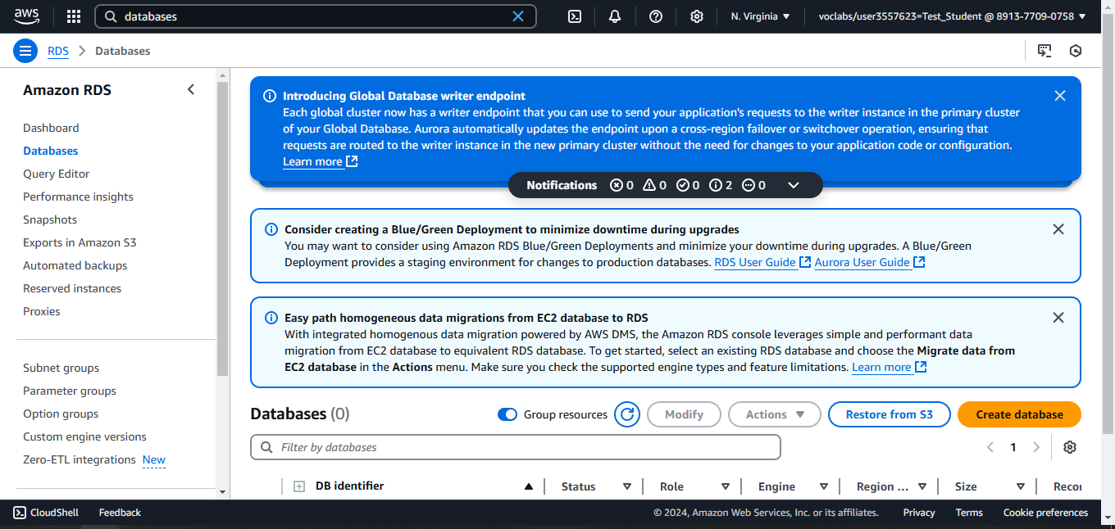
Create a Database

Slide 53

Select MySQL

Slide 54

Choose the template

Slide 55

Choose Multi-AZ DB instance

Slide 56

Configure the name, and Password

Slide 57

Select the instance class and type

Slide 58

Configure the storage type and size

Slide 59

Configure the VPC

Slide 60

Select the security group (DB Security Group)

Slide 61

Uncheck the Enable Enhanced Monitoring field

Slide 62

Uncheck the Enable auto minor version upgrade

Slide 63

Wait for the DB to be created

Slide 64

Copy the Endpoint link

Slide 65

Copy the Web Server IP

Slide 66

Paste the IP in the browser

Slide 67

Go to the RDS and configure the fields

Slide 68

You can access the DB and modify it

Slide 69


Slide 70


Slide 71


Slide 72


Slide 73
DynamoDB
Fully Managed Highly available with replication across 3 AZ
NoSQL database - not a relational database
Scales to massive workloads, distributed “serverless” database
Millions of requests per seconds, trillions of row, 100s of TB of storage

Slide 74


Slide 75


Slide 76


Slide 77


Slide 78



Slide 79


Slide 80


Slide 81


Slide 82


Slide 83


Slide 84


Slide 85


Slide 86


Slide 87


Slide 88


Slide 89


Slide 90


Slide 91


Slide 92


Slide 93


Slide 94


Slide 95


Slide 96


Slide 97

Notes:
B

Slide 98

Notes:
B DynamoDB

Slide 99

Notes:
scan

Slide 100

Notes:
D all the above

Slide 101

Notes:
D redsfhift

Slide 102

Notes:
A data elements

Slide 103

Notes:
C dynamodb

Slide 104

Notes:
C complex transactions

Slide 105

Notes:
D aurora

Slide 106

Notes:
true

Slide 107

Notes:
D all the above

Slide 108
Questions
1- Which of the following Database Services is a NoSQL Database
Amazon Aurora
Amazon RDS
Amazon DynamoDB
Amazon Redshift
Notes:
C. Amazon DynamoDB

Slide 109
Questions
2- Which relational database is a proprietary technology from AWS and is cloud-optimized?
DynamoDB
Oracle
Athena
Aurora
Notes:
D. Aurora

Slide 110
Questions
3- You would like to set up a NoSQL database that can scale with no downtime and can handle millions of requests per second. Which AWS database is best suited for this work?
DynamoDB
RDS
Redshift
Athena
Notes:
A. DynamoDB

Slide 111
Questions
4- RDS is a Serverless database
True
False
Notes:
B. False

Slide 112
Questions
5- NoSQL Databases have flexible schemas for building modern applications
True
False
Notes:
A. True

